Slide 1
Strategic Solutions: Mitigating Caladan’s COVID-19 Crisis
Team 5

Slide 2




Meet the Team
Joshua Leeds
Parin Shaik
Jimin Park
Anmar Abdi
Project Manager; CDS ’26
BI Analyst; CDS ‘26
Data Architect; CDS ‘25
Data Engineer; CDS ‘26

Slide 3
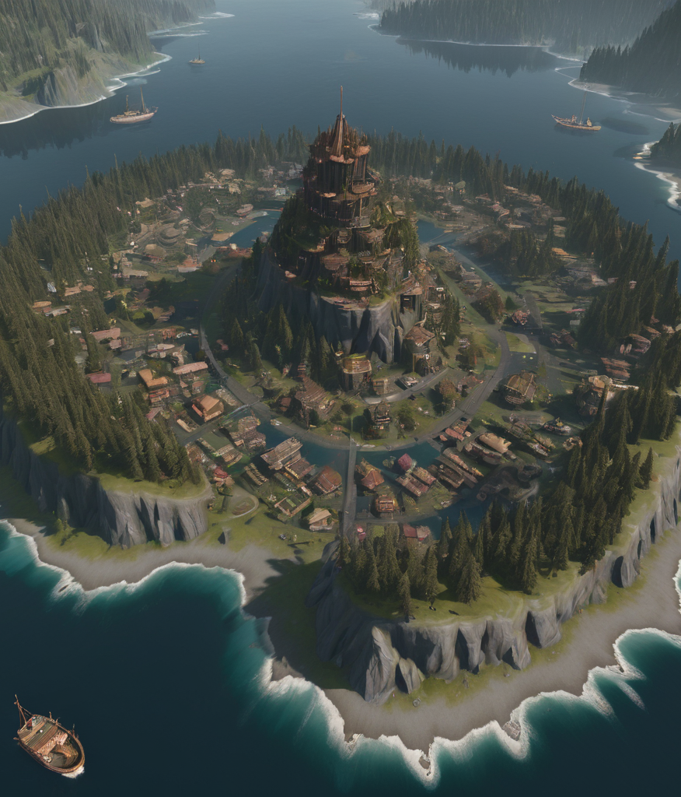
What is Caladan?
We are a mid-size commonwealth located in the southern Atlantic ocean with two main hubs of commerce–Duncan and Stillgard–and a population of 3.2 Million. The nation runs on a Seferlian governing system.

Slide 4
Keeping Caladan Safe
To remain Covid-19 free, we recommend implementing the following policies:
1.
Moderate/Low Stay-at-Home Requirements
2.
Enforcing Testing Guidelines
3.
Moderate Restriction of International Travel

Slide 5
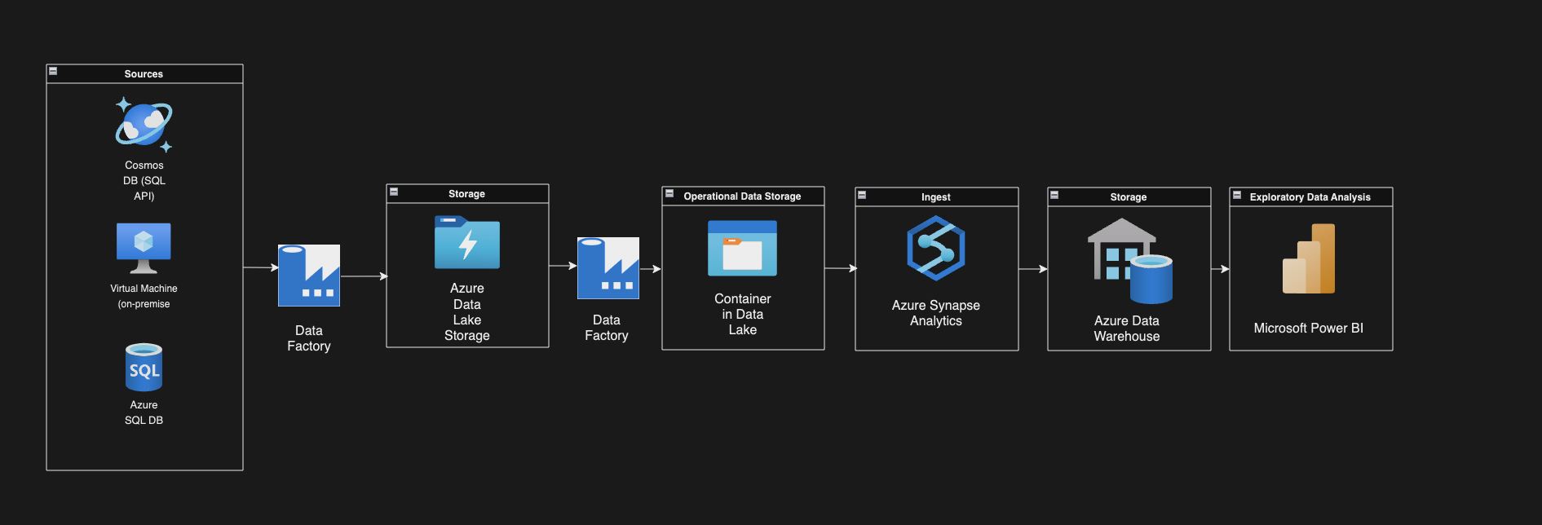
Project Architecture

Slide 6
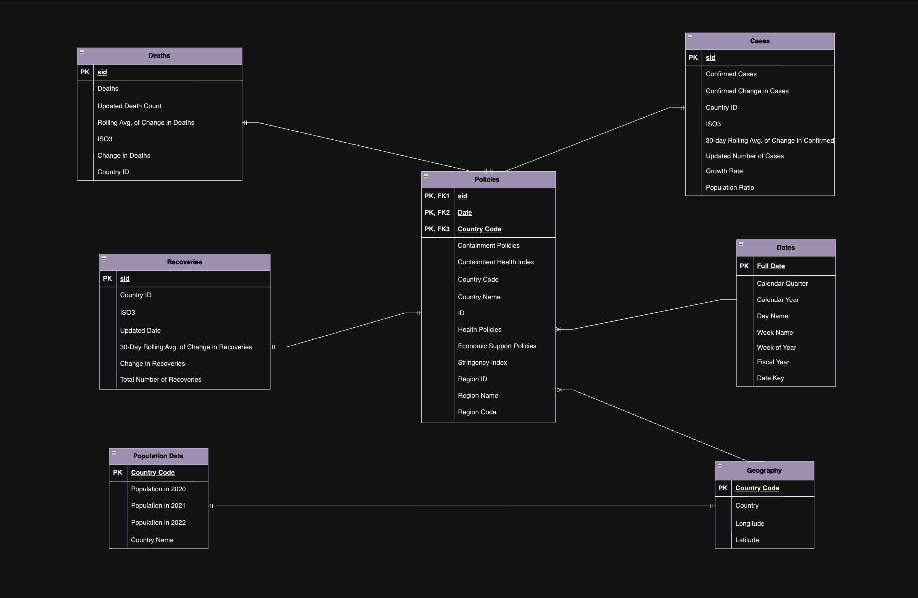
Data Model

Slide 7
PowerBI
Demonstration

Slide 8
Thanks!
Team 5

